Slide 1





Being a DBA in a DevOps world
Alessandro Alpi
Notes:
Hi everyone, I’m Alessandro Alpi, a Microsoft Data Platform MVP from Italy since 2008. In this “small talk”, I’m gonna tell you how the role of the DBA has changed and is still changing in a DevOps world from my perspective. I’ll show you my professional development, in a nutshell, then, I’ll try to describe the cultural and operational changes. Finally, I’d like to share with you some advices to make the change less painful.

Slide 2
My story so far
Started out in the 1999, yes I’m old
Developer with FoxPro, Java, ASP, .Net until 2003 and SQL Server
Many years with SQL Server, DBA
Worked also with other DBMS, like Oracle, IBM DB2, NoSQL and so on
Mindset: always “DevOps”
I’ve changed many times.

Slide 3
The (former) DBA
Hardware knowledge
Networking knowledge
O.S. knowledge/Software
Oh, I almost forgot this one: Database management systems knowledge!
Ok, what is a DBA?
Notes:
A DBA should know many things about networking, hardware, operative systems, and software in general. We can’t manage a SQL Server setup without understanding how a storage subsystem will react to our settings. At the same time, we can’t make improvements if we don’t know how the software installed is working against our SQL Servers. With software I mean both the home-made solutions and components, but also the tools installed server-side. Then, as SQL Server sends and receives data (which is a server-to-server request/response, actually) we must understand protocols and measure the bandwidth we’re dealing with.
Finally, the most important thing, we must know everything about persistence, modelling and in general how a DBMS works, especially behind the hoods. Monitoring and getting our platform always up and running is one of our main objectives to accomplish.
A former DBA can be considered as a specialist which acts as the «committer» of any delivery in production which involves data. Anyways, the DBA should be more than this, but in my experiences, many of them just check for updates, validate and execute scripts, give permission and configure SQL Server Instances. When required, they setup new instances, but in some cases this task is delegated to external vendors. Something should may change.

Slide 4
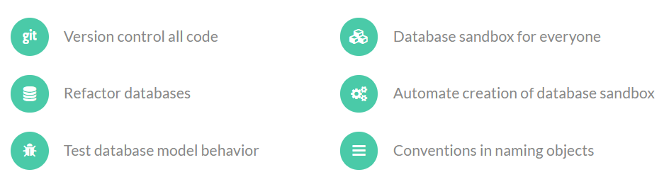
DevOps for DBA

Slide 5
From administrators…
Working often on production systems
Acting as an Operation guy
Ignoring the dev’s work (how to)
Ignoring what happens “before us”
Keeping distances from other depts
Notes:
The DBAs used to work mostly in production systems, acting as an “operation guy”. What does it mean?
First, many DBAs get the packages and then, they release them without knowing anything on their content.
This means that they’re ignoring the “how” focusing on the “what” and “when”. They must release with no troubles.
Unfortunately, silos will be created around the DBAs. A silo leads to more distances between development and database admins.

Slide 6
…to engineers
Working together with operations and development teams
Acting as an engineer, with system thinking early in the project
Breaking down the barriers with development
Automating the manual tasks
Being committed from the start of the project
No “one man band” and no “hero syndrome”
Database reliability engineering (DBRE)
Notes:
An engineer is slightly different. An engineer takes advantages in working with both DBAs and Operations and is focused on system thinking, early in the project.
This kind of professionals are always involved and share their ideas and thoughts with all the teams and the tech departments.
They must follow all the pipeline, from development to deployment, and after the deployment with monitoring tools (which is what DevOps is focused on, too). This is commitment.
No “heroes”, no people which can’t sleep or leave the work for just a single day. No silos, no barriers between team, strong commitment.
Another important thing to consider is to transform every manual task in an automated one. Thus, we can reduce the wasting of time and the human errors’ rate.
This professional is called Database Reliability Engineer and I think that every DBA should move to (or take from) this approach.

Slide 7
From gatekeepers…
Everything is mission-critical, because it’s data
Stop any release on mission-critical targets (everything)
Let’s centralize on us all the rules and validations
As a result: release flow slowed down
Notes:
A former DBA is often a gatekeeper. This means that everything which is related to “data” is a mission-critical item.
Thus, no release can be done against databases, because is mission-critical, so the gatekeeper must stop the process and check for the shape of the packages. Unfortunately, the most of time, the DBA is not free for these reviews and validations, so, stopping the release, avoiding any error, leads to a bottleneck.
The result is obvious: despite the good intentions, we’re slowing down the deployment. We’re breaking it, no deploy will be done soon. Additionally, the more is the time between two releases, the bigger is the probability to break the production databases, because too large packages will modify too much objects. More locks, more errors, more regressions.

Slide 8
…to facilitators
Try to make everything easier and clear the obstacles
Delegate work to trusted people and build trust within the team
Let’s release more frequently, so the releases will be less risky
As a result: continuous delivery, forget about automatic tasks
Notes:
A DBA should be a facilitator, since we would like to release more frequently. The lesser is the time between the releases, the smaller will be the release packages. More quick deployments, less problems at all, less risks.
A facilitator doesn’t stop anything, it clears the obstacles instead. It makes everything easier. I’m not saying that no checks or rules should be done but releasing the “locks” can reduce the concurrency problems, speaking in database dictionary.
DBAs should gather trusted people and delegate to them many activities. This helps everyone to be more “DevOps” and to build the confidence and the trust between people in a team and with other teams. Also, the automation is not a problem anymore.
The target is to forget about the automated deployments, they just work! When you reach this goal, you can scream out loud “I’m DevOps” ☺

Slide 9
Changing ourselves
This is the problem

Slide 10
My two cents
Change your way of work since the beginning
Be involved in development and team management
Design the deployment with developers and operations
Be proactive in monitoring and committed about the solution you deliver
Share your thoughts, it can be useful for everyone
Take advantage from collaboration using collaboration tools
Participate to the software lifecycle
Notes:
Changing ourselves is not simple, we all know this. Anyways, changing our habits step by step is something we can deal with better. When I say “change your way of work since the beginning” I mean that we can re-start to think about our job. Every day, I’ve asked myself (for many years) “what can I do to improve our solution?”. This allows us to forget our legacy activities and let’s us to be proactive since the beginning of the project we’re working on. So, we start speaking about “projects” not just “deployments”, we start speaking with the business concepts and work with a business glossary to understand better and better WHY we are doing something.
While dealing with developers, we can be proactive helping them modeling objects and tuning their queries (or the queries generated by the ORMs), share our thoughts with them, helping them to model the database avoiding regression and enhancing backward compatibility patterns, and so on. At the same time, we can learn from the way they work, which is not less important. Also, with developers and operations, we can start thinking about how we will deploy our entire solution to production (not just the database itself).
While dealing with continuous integration, testing and deployments we can take advantage from the collaboration tools, like Azure DevOps for all the build and release task, slack, zoom, teams for meeting and sharing screens, and so on. This should help us to be involved in anytime in the project, both for requirements and the pipelines (the Operation part). Then, we should start using the DevOps glossary, with terms like “artifacts”, “packages”, “pipelines” and so on.

Slide 11
My two cents
Understand the business value
Understand the customer satisfaction
Make a trusted workflow
Reduce the wasting of time considering provisioning data
Consider a set of tools for generating new instances (dbatools rulez!)
Consider the right metrics to measure in monitoring
Notes:
Our job is not based on “take a package and release it” pattern. So, it’s important to understand the business value of everything we do, from tech stuff to features. Thanks to this, we can get an insight about the customer satisfaction as well as the customer frustration when we make a change that breaks down the environment. This metric is one of the most important, business and tech side. Working in enterprises should force us to move to this approach, because we can’t just deal with executing some scripts, checking policies and doing some permission tasks nowadays.
While working with development and operations team, we can make a trusted workflow, that is a set of processes with trusted people, focused on creating a pipeline we can forget about execution after execution. As we’ve already said, the trust with automated tasks is got step by step, not all in one.
When you need to help developers to gather data or you’d like to execute integration tests, consider the option to make a solution that allow a fast data provisioning, taking advantages from tools like docker, spawn or similar. With these, you can quickly get data and environments both for the developer sandboxes and test servers, especially in automation. For new customers, instances, or everything which is “brand new”, consider using open-source tools, like dbatools.io with which you can migrate, manage, create and configure instances with a few lines of PowerShell.
Finally, the commitment after releasing in production. The monitoring. This is the simplest task for a DBA to consider. Monitoring is a part of the foundation of a classic DBA role, so, hopefully, we will be ready as soon as we start to setup a monitoring tool. The difference is on the monitoring style. Installing, configuring and checking a monitoring tool aren’t the only things we should do. With DevOps approach, we would like to make the monitoring proactive. This means that something well designed, will alert us before the problem occurs. How? Integrating the alerts with our collaboration tools, like slack or teams, with bots, for instance.

Slide 12
Stats
insights

Slide 13
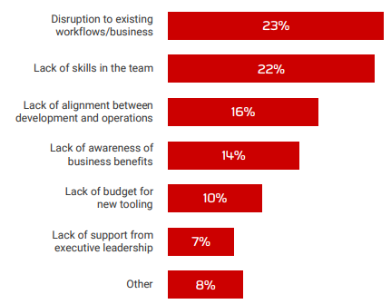
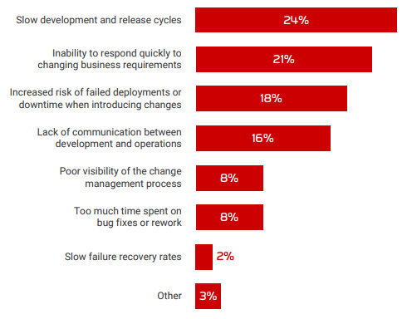
Obstacles&drawbacks adopting DevOps
Obstacles Drawbacks
The database state of DevOps 2020 - RedGate

Slide 14
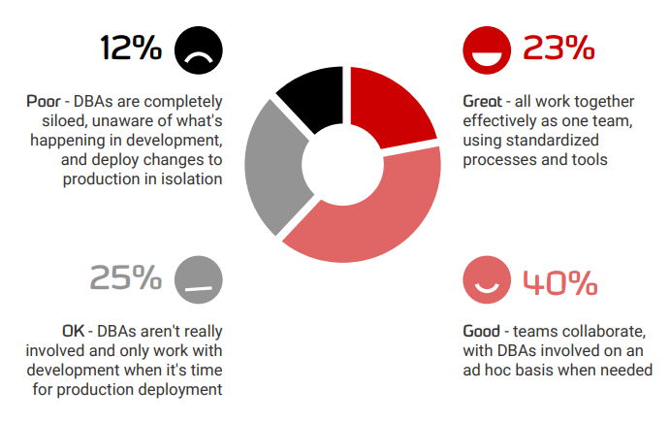
DBAs & Developers
The database state of DevOps 2020 - RedGate

Slide 15
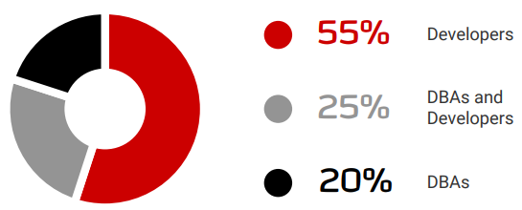
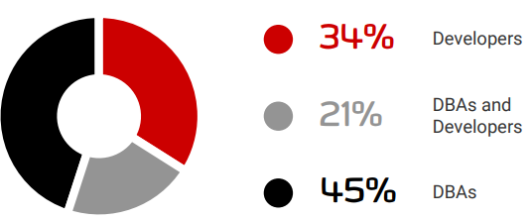
Script authoring & deployment
Who authors Who deploy scripts
The database state of DevOps 2020 - RedGate

Slide 16
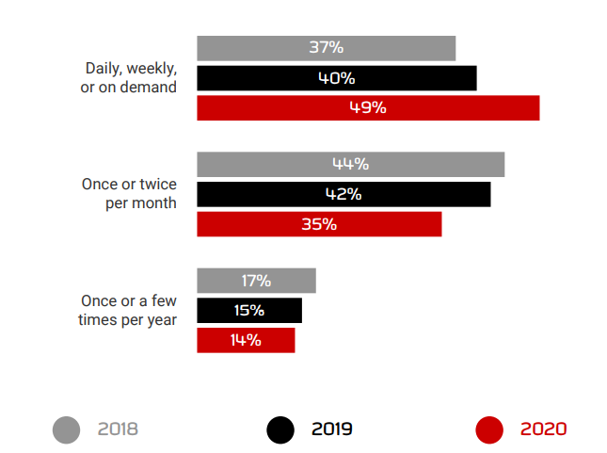
Deployment frequency
The database state of DevOps 2020 - RedGate

Slide 17
Resources – books
Database reliability engineering
https://www.amazon.com/Database-Reliability-Engineering-Designing-Operating/dp/1491925949/ref=sr_1_1?crid=32NTZ77EA0T6F&dchild=1&keywords=database+reliability+engineering&qid=1610730047&sprefix=database+rel%2Caps%2C243&sr=8-1
Refactoring databases
https://www.amazon.com/Refactoring-Databases-Evolutionary-Database-Design/dp/0321293533/ref=sr_1_1?crid=1RZTUQ0SGZXAW&dchild=1&keywords=database+refactoring&qid=1610730087&sprefix=database+refa%2Caps%2C246&sr=8-1
Release It!
https://www.amazon.com/Release-Design-Deploy-Production-Ready-Software/dp/1680502395/ref=sr_1_1?dchild=1&keywords=release+it&qid=1610730133&sr=8-1

Slide 18
Resources – tools and pages
dbatools.io
https://dbatools.io/
spawn
https://www.spawn.cc/
devopsfordba
https://devopsfordba.com/

Slide 19
Thank you for participating in this event, donations will be used to help rebuild schools, homes and lives of people that were effected badly by earthquakes in Croatia 28.-29.12.2020.
Updates on donations: https://gogetfunding.com/sisakpetrinjastrasnik-earthquake-relief/ more info & organizer contact: https://mvps4croatia.com/

